Slide 1


SOYEZ LES BIENVENUS
Au 7e COLLOQUE Scientifique
International des universités de PARAKOU ET KARA

Slide 2
Artificial Intelligence (AI) and its Impacts on EFL Teaching-Learning at tertiary education: The case study of University of Parakou
Written and Presented by:
N’TOUA M’PO Karim, Doctorant à la FLESH de l’Université de Kara-UK, Campus Sud.
Dr. Abdoulaye HAKIBOU, Maître de Conférences des Universités du CAMES, Linguistique Anglaise à l’Université de Parakou (UP)
Septembre 2024

Slide 3
OUTLINE
Introduction
Problem Statement
Objectives
Research questions
Methodology
Literature Review
Findings
Recommendations and Suggestions
Conclusion

Slide 4
INTRODUCTION
Artificial Intelligence (AI) is transforming various sectors, including education, specially at tertiary level.
The integration of AI into high education can improve students communicative competences and prepare them for their future career.
This research work investigates the impact of AI on EFL teaching-learning at University of Parakou.
AI tools like speech recognition and translation software break down language and accessibility barriers, enabling individuals with disabilities or non native speakers to access educational content (Holmes et al., 2019)

Slide 5
PROBLEM STATEMENT
AI adoption in African universities, particularly in Benin, remains limited due to infrastructural, financial, and policy constraints.
There is a lack of empirical research that examines the specific impact of AI on students in this context.
This article seeks to fill that gap by focusing on the University of Parakou, where AI is gradually being introduced in various educational processes

Slide 6
OBJECTIVES
OG: Explore how AI tools are being adopted in EFL teaching-learning at the University of Parakou, assess their impact, and identify the challenges faced
OS1: Explore the ways in which AI is being used in teaching, learning, and administration at the University of Parakou
OS2: Assess the impact of AI on student engagement, learning outcomes, and academic performance.
OS3: Identify the challenges and barriers to AI adoption in tertiary education in Benin.

Slide 7
RESEARCH QUESTIONS
RQ1: How is AI being integrated into the academic and administrative processes at the University of Parakou?
RQ2: What are the perceived benefits and drawbacks of AI from the perspective of students and educators?
RQ3: How does AI influence student engagement, learning outcomes, and overall academic performance?
RQ4: What challenges and barriers exist in the adoption of AI at the University of Parakou?

Slide 8
METHODOLOGY
Class observation
10 Lecturers
Target population
Techniques of data collection
Lecturer Meeting
50 Students
AI Training
Documentary research
Conferences
Methods of data collection
Instruments of data collection
Field investigation
Questionnaire sheets

Slide 9
FINDINGS (1/4)
1. Integration of AI in University of Parakou
Adaptive Learning Platforms: Some courses have begun using AI-powered platforms that adjust content delivery based on student performance and engagement.
AI-driven Assessment: Automated grading systems are being piloted in certain faculties, reducing the workload for instructors and providing quicker feedback to students.
Virtual Assistants: A few departments have adopted AI-based chatbots to assist students in navigating academic resources and administrative services.

Slide 10
FINDINGS (2/4)
2. Perceived Benefits of AI in Learning
Personalized Learning: AI-enabled systems adapt to the individual learning pace of students, allowing them to grasp complex subjects more effectively.
Efficiency: Automated systems streamline administrative tasks like grading and scheduling, giving faculty more time to focus on instruction.
Improved Student Engagement: Interactive AI tools, such as virtual tutors, keep students engaged and make learning more dynamic.

Slide 11
FINDINGS (3/4)
3. Challenges in AI Adoption
Infrastructure Gaps: The lack of reliable internet and access to necessary hardware hampers the effective deployment of AI tools.
Resistance to Change: Some faculty members expressed resistance to adopting new technologies, citing concerns about job displacement and loss of personal interaction with students.
Equity Issues: There is a growing digital divide between students who have access to AI tools and those who do not, leading to unequal learning experiences.

Slide 12
FINDINGS (4/4)
3. Impact on Student Learning and Performance
Students who use AI-enabled platforms tend to perform better in their coursework compared to those who do not.
However, the improvements in learning outcomes were more pronounced in science and technology faculties than in humanities faculties, where AI use was less widespread.

Slide 13
RECOMMENDATIONS AND SUGGESTIONS (1/2)
Infrastructure Development: The government and university administration should invest in upgrading digital infrastructure, including internet access and AI-compatible devices.
Capacity Building: Training programs should be introduced for both faculty and students to enhance their understanding of AI and its applications in education.

Slide 14
RECOMMENDATIONS AND SUGGESTIONS (2/2)
Policy Frameworks: There is a need for clear policies regarding the ethical use of AI in education, particularly concerning data privacy, academic integrity, and equitable access.
AI Integration in Curricula: AI should be fully integrated into the curricula across all faculties to ensure that students in all disciplines benefit from its potential.

Slide 15
CONCLUSION
AI has a significant positive impact on student engagement, learning outcomes, and administrative efficiency at the University of Parakou.
However, the benefits are unevenly distributed, with some faculties and student groups experiencing greater advantages than others.
The challenges related to infrastructure, digital literacy, and resistance to change need to be addressed to ensure equitable access and full utilization of AI’s potential in education.

Slide 16
CONCLUSION (2/2)

Slide 17
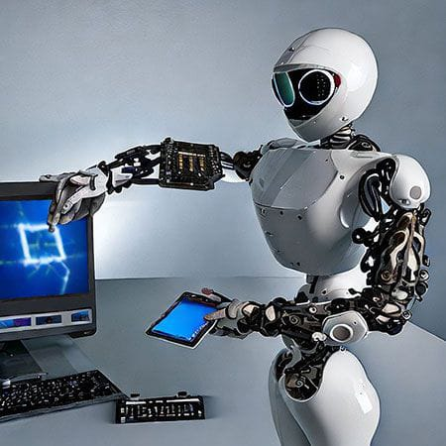
THANKS FOR YOUR KIND ATTENTION

